Slide 1
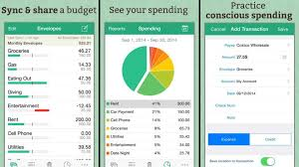
Budget Daily
A budget tracker for everyday life
Creator: Matt Reynolds
Github Link: https://github.com/mtreynolds55/everyday-budget

